Slide 1
Transfer Learning using VGG-16 Model
Presenter: Mukesh Badigineni (108998405)
Instructor: Dr. Kuan-Ting Lai

Slide 2
Objective:
In the constraint of less input data or model with moderate performance we can implement the Transfer Learning to improve our model performance.
Transfer Learning:
Reusing the weights in one or more layers from a pre-trained model in a new model and either keeping the weights existed or fine tuning them.
Our model will be “Truncated” with the Pre-Trained Model.

Slide 3
Motivation:
During the HW1 of our Building Learning Subject my senior friend suggested me to apply this method.
It will improves the model performance.
But the truncated models should have similarity in either domain (feature space or marginal space) or Task (label space or conditional space)
Then only the network truncating will gives a better performance.

Slide 4
25000
Collection of cat and dog images (12.5k) each.
Data Set
3000
Purposely I reduced the train data set to 3000 Images (1.5k each type)
1000
Randomly 1k Images selected for validation (.5k each)
1000
Randomly 1k Images selected for Testing (.5k each)

Slide 5
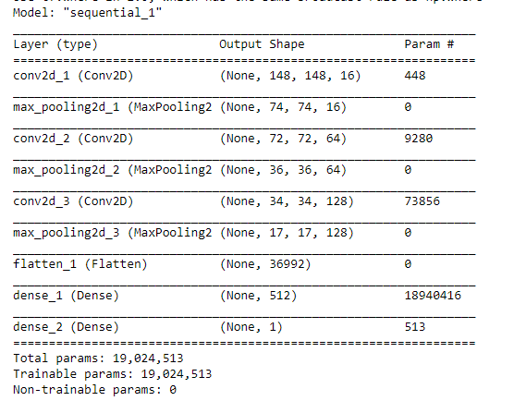
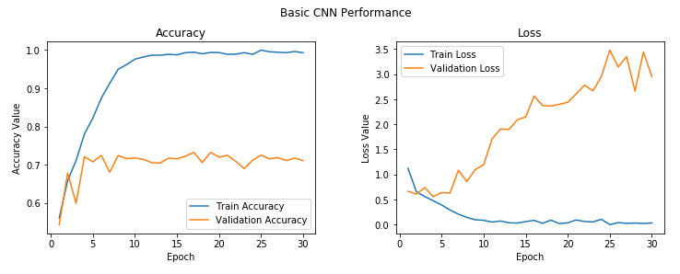
Simple CNN Model:
I built a simple CNN model with following parameters.
After successful training with 30 epochs the performance is as follows.
We can observe overfitting after few epochs itself.
The val_acc is around 0.71
Layers | 3
Activation | Relu
Optimizer | RMS
Batch Size | 30
Data_Size | 3000
Epochs | 30

Slide 6
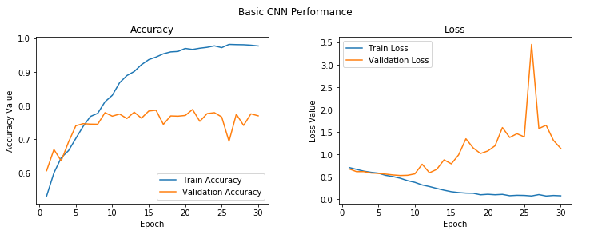
In order to control the overfitting I add dropout of 0.4 to the hidden layers.
Then adding another dense layer to the model.
With these parameters the model performance is as follows.
We can see after adding dense layer and dropout the over fitting is better controlled.
The performance is also increased to 0.761.
But there is a sudden spike in loss due to the less amount of data.

Slide 7
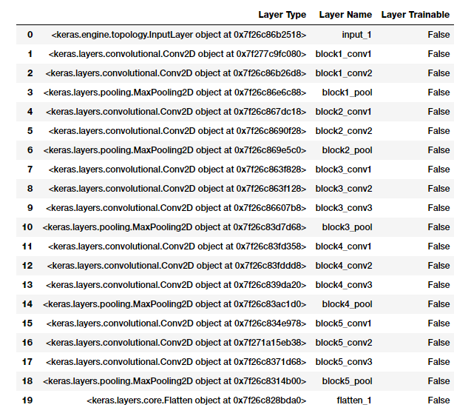
Transfer Learning using VGG-16
All The layers of VGG-16 will be kept in frozen
Will extract the Bottleneck Features from block5_pool
All these features used to feed as input to our model

Slide 8
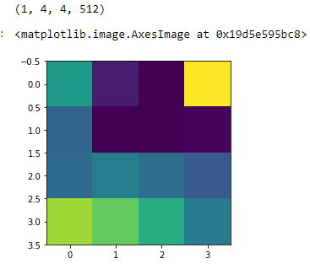
Bottleneck Features:
The bottleneck features look like for a sample image in training data.
The features from vgg_model should be flattened to feed the model.
The extracted bottleneck features of the train data and validation data is attached below.

Slide 9
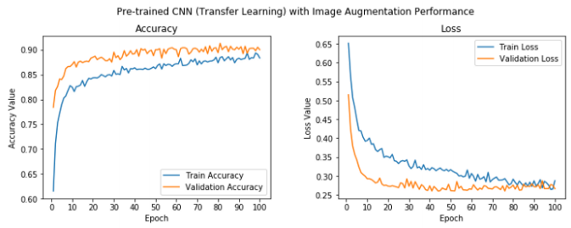
Then I tried the model with all these inputs.
The performance is much better than before.

Slide 10
Performance Improvement
Dropout
Transfer Learning
By controlling the overfitting model made slightly better performance
Truncating VGG-16 with our model there is a jump in performance.
0.761
0.901
0.713
!?
Basic CNN
Neptune
With simple network the model learnt is moderate.
Still there is a scope to look for better models.

Slide 11

THANK YOU
Reference:
https://ieeexplore.ieee.org/stamp/stamp.jsp?tp=&arnumber=8921342&tag=1
https://ieeexplore.ieee.org/stamp/stamp.jsp?tp=&arnumber=8750909
https://ieeexplore.ieee.org/stamp/stamp.jsp?tp=&arnumber=8906043

